Slide 1
Building ML Pipelines with Kubeflow: A Complete Guide for MlOps

Slide 2
Why Kubeflow?
Machine Learning in production is hard. While building models in Jupyter notebooks feels easy, scaling and operationalizing them brings new challenges:
Reproducibility — Can you guarantee the same results every time?
Scalability — Can your workflow handle large datasets and multiple experiments?
Collaboration — How can teams easily share and track ML experiments?
Monitoring — How do you keep an eye on model performance post-deployment?
Versioning — How do you manage different model and data versions
That’s where Kubeflow comes in.

Slide 3
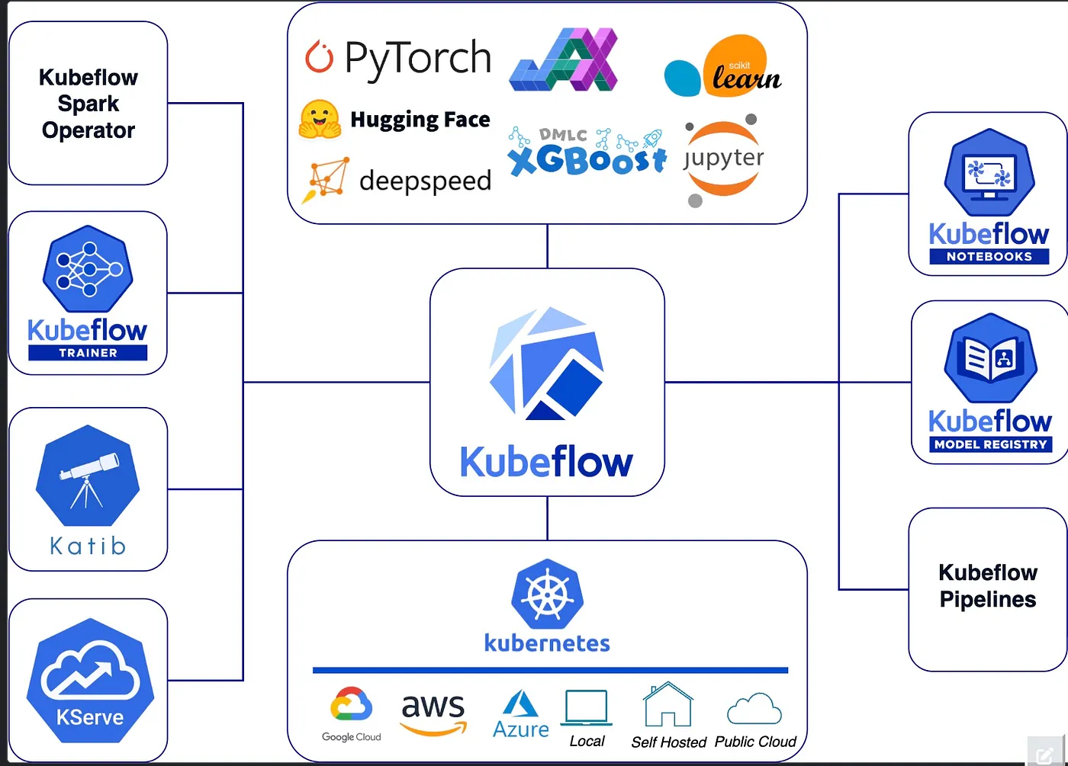
Kubeflow
Kubeflow is an end-to-end MLOps platform built on Kubernetes, designed to handle the entire ML lifecycle — from experimentation to deployment and monitoring — all in one place.

Slide 4
What Problems Does Kubeflow Solve?
1. Experiment Tracking & Reproducibility
Every experiment is automatically tracked with datasets, code, and parameters.
You can reproduce past results exactly.
Compare multiple model versions side by side.
2. Scalable Training
Run distributed training jobs across multiple nodes.
Handle massive datasets with flexible compute (CPU, GPU, TPU).
Scale up or down dynamically based on workloads.
3. Model Deployment
Serve models as microservices.
Perform canary or A/B testing.
Auto-scale based on demand.
4. Pipeline Orchestration
Chain ML steps together (data prep → training → evaluation → deployment).
Handle dependencies automatically.
Retry failed steps for resilient execution.

Slide 5
Understanding Kubeflow Components
Kubeflow is modular. Each component focuses on a specific stage of the ML lifecycle:
Component Purpose Kubeflow Pipelines Workflow orchestration, experiment tracking Jupyter Notebooks Interactive development Katib Hyperparameter tuning KFServing Model serving and inference Kubeflow Training Distributed training operators Kubeflow Metadata Artifact and lineage tracking
Here, we’ll focus on Kubeflow Pipelines, the orchestration engine that allows you to:
Define workflows as Python code
Run reproducible experiments
Track metrics, logs, and artifacts
Collaborate efficiently across teams

Slide 6
Prerequisites (Local Setup)
Before getting started, make sure you have:
Docker Desktop installed and running
macOS or Linux terminal
8GB+ RAM (recommended)
Basic knowledge of Python and Kubernetes
While in GCP we can provision GPU Backed Nodes with L4/T4 GPUs to support kubeflow deployment.

Slide 7
Steps
Step 1: Install Kind (Kubernetes in Docker)
Kind lets you run Kubernetes clusters locally using Docker — perfect for testing and development.
brew install kind kind version
Step 2: Create a Local Kubernetes Cluster
kind create cluster --name kind-cluster kubectl cluster-info --context kind-kind-cluster
You should now have a single-node Kubernetes cluster running locally.

Slide 8
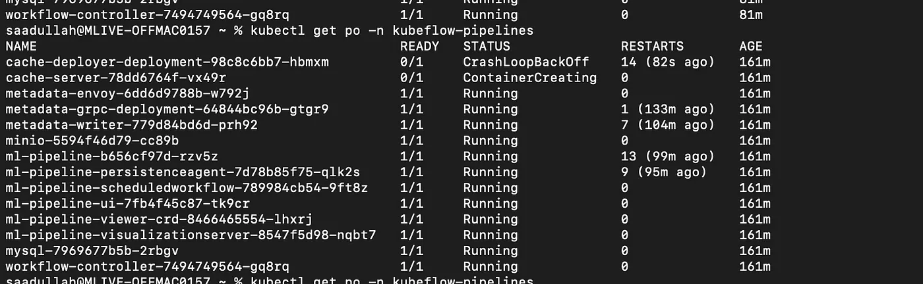
Steps
Step 3: Install Helm (Kubernetes Package Manager)
Helm simplifies Kubernetes app deployments using prebuilt charts.
brew install helm helm version
Step 4: Install Kubeflow Pipelines via Helm
We’ll use the GetInData Helm chart — a simplified way to install Kubeflow Pipelines:
helm repo add getindata https://getindata.github.io/helm-charts/ helm repo update
helm install my-kubeflow-pipelines getindata/kubeflow-pipelines \ --version 1.6.2 \ --set platform.managedStorage.enabled=false \ --set platform.cloud=gcp \ --set platform.gcp.proxyEnabled=false \ --namespace kubeflow-pipelines \ --create-namespacekubectl get pods -n kubeflow-pipelines
Wait for all pods to reach the Running state.

Slide 9
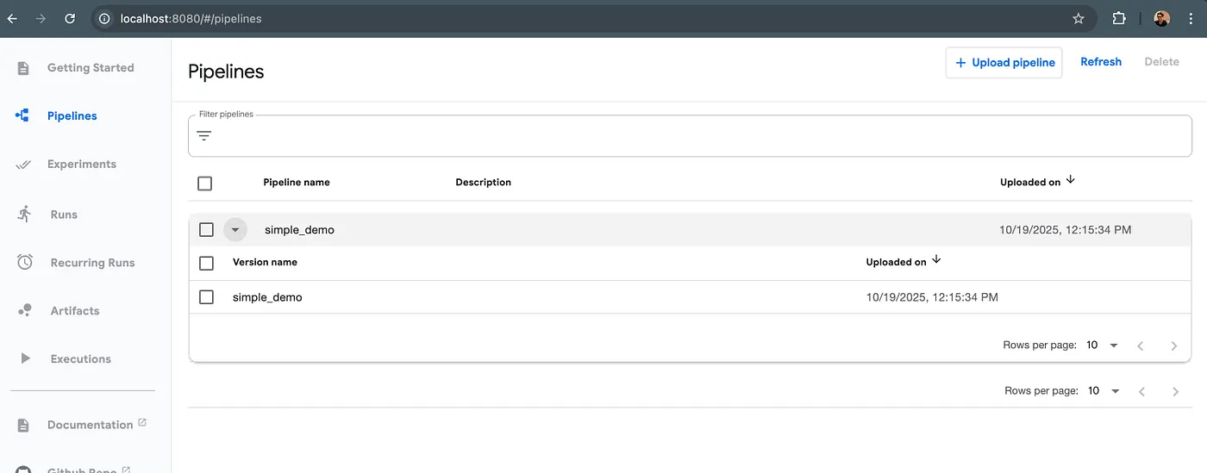
Steps
Step 5: Access the Kubeflow UI
Forward the Kubeflow UI service to your localhost:
kubectl port-forward -n kubeflow-pipelines svc/ml-pipeline-ui 8080:80
Now, open your browser and visit: 👉 http://localhost:8080

Slide 10
Steps
Step 6: Set Up Your Python Environment
Let’s create a Python environment for defining our ML pipelines.
mkdir kfp && cd kfp python3 -m venv .kfp source .kfp/bin/activate
pip install kfp==2.14.6 python3 -c "import kfp; print(f'KFP version: {kfp.__version__}')"

Slide 11
Steps
Step 7: Build an ML Pipeline
Our demo pipeline will:
Generate a synthetic dataset
Split it into train/test sets
Train a rule-based classifier
Evaluate metrics
Generate a simple report
Here’s a simplified version of the pipeline YAML: another_kubeflow_pipeline_demo.yaml
kubeflow-pipeline-demo.yaml

Slide 12
Steps
Step 8: Upload & Run the Pipeline
Upload Pipeline
In the Kubeflow UI → “Upload Pipeline”
Select your simple_demo.yaml file
Click Upload
Run Pipeline
Select your pipeline
Click Create Run → Start

Slide 13
Steps
Step 9: Monitor Pipeline Execution
As the pipeline runs, you’ll see:
Real-time logs and status updates
Execution times for each step
Output metrics and visual artifacts
A DAG (Directed Acyclic Graph) visualization

Slide 14
Understanding the ML Pipeline
The Model
Our model is a rule-based classifier:
If the sum of three features > 15 → Predict 1, else 0.
It’s intentionally simple — perfect for demonstrating reproducible ML pipelines.
Pipeline Steps
Data Generation — Creates 1,000 samples
Split — 80/20 train-test split
Train — Applies classification rule
Evaluate — Calculates Accuracy, Precision, Recall, F1
Report — Generates a concise summary

Slide 15
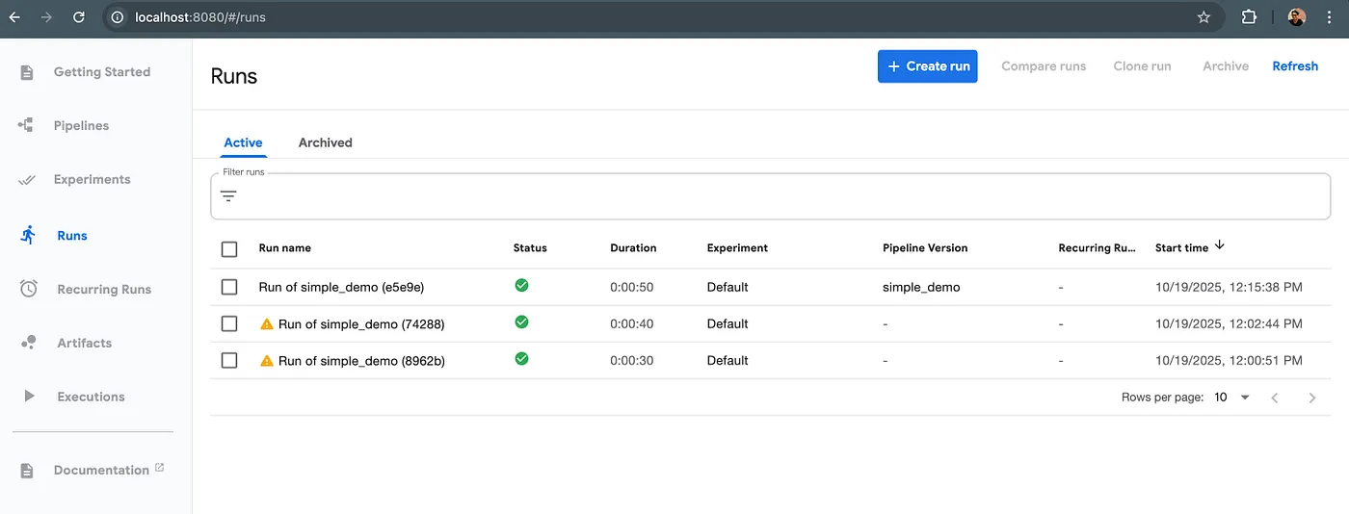
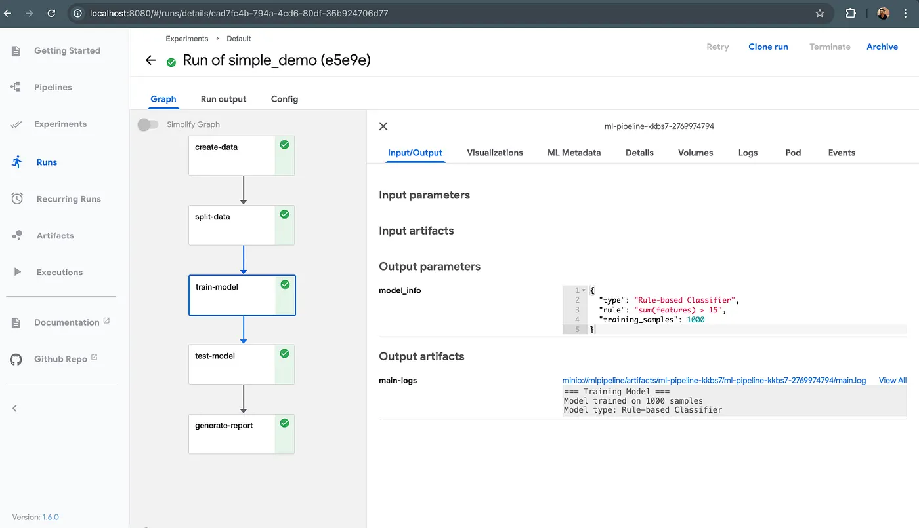
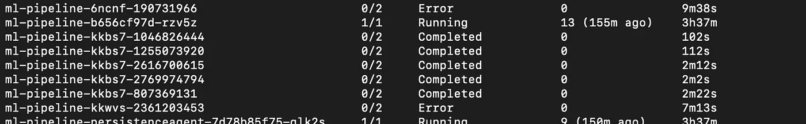
Understanding the ML Pipeline
Model training steps
created. jobs for our model training

Slide 16
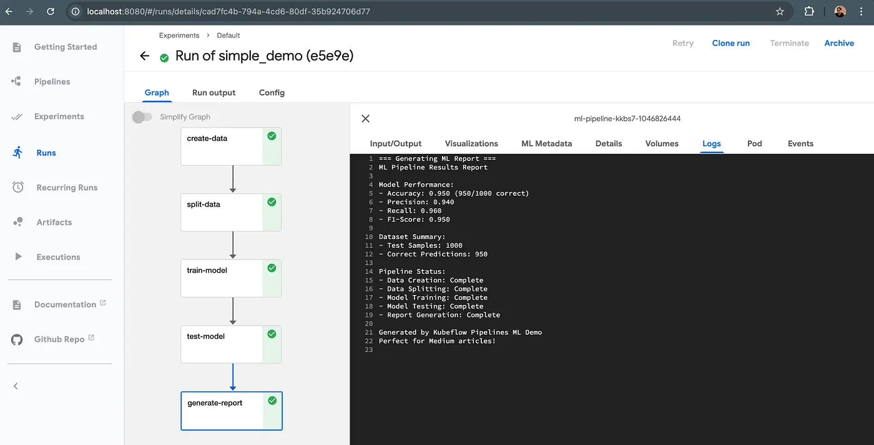
Understanding the ML Pipeline
Expected Metrics:
Accuracy ≈ 95%
Precision ≈ 94%
Recall ≈ 96%
F1-Score ≈ 95%
Model training results

Slide 17
What’s Next?
Now that Kubeflow Pipelines are running locally, you can:
Build More Complex Pipelines
Integrate scikit-learn or TensorFlow models
Add data preprocessing, validation, and monitoring steps
Leverage Katib for automated hyperparameter tuning
Scale to Production
Deploy pipelines to cloud Kubernetes clusters (EKS, GKE, AKS)
Integrate CI/CD with GitHub Actions or Argo CD
Add model drift detection and real-time monitoring
Collaborate & Iterate
Share pipelines across teams
Version control your workflows
Automate experiments for faster iteration

Slide 18
Summary
Pods Not Starting
kubectl get pods -n kubeflow-pipelines kubectl logs <pod-name> -n kubeflow-pipelines
UI Not Accessible
kubectl port-forward -n kubeflow-pipelines svc/ml-pipeline-ui 8080:80
Clean Restart
kind delete cluster --name kind-cluster kind create cluster --name kind-cluster
Notes:
✅ Created a local Kubernetes cluster with Kind ✅ Installed Kubeflow Pipelines via Helm ✅ Built and deployed a working ML pipeline ✅ Monitored and analyzed pipeline results
Kubeflow Pipelines bring structure and scalability to your ML projects — making them:
Reproducible — same results every run
Scalable — handle any data size
Collaborative — work with your whole team
Observable — track models across their lifecycle
This is your first step into the world of MLOps with Kubernetes. The skills you’ve learned here can scale to real-world production systems.

